Slide 1

Special Topic: Cybersecurity
Networks

Slide 2
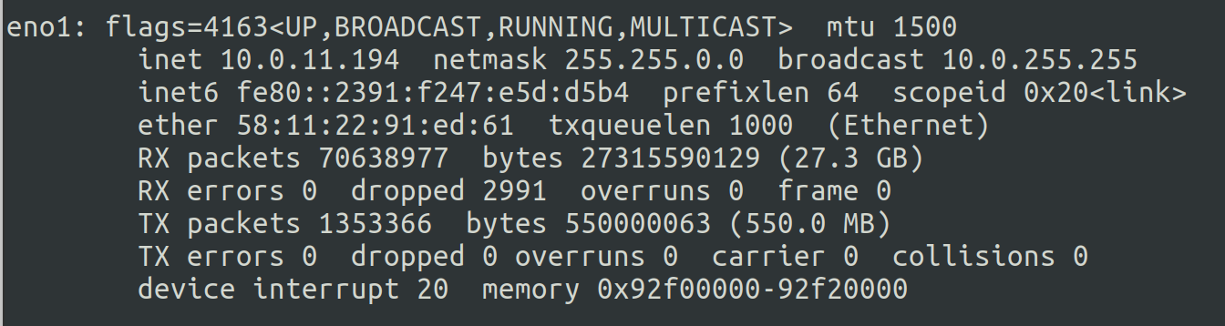
1. IP Addresses
2 types of IP addresses: IPv4 and IPv6
On Linux, you can use the command ifconfig to show information about your connections

Slide 3
1. IP Addresses
inet is the IPv4 IP number and is made out of 8x8x8x8 bits
inet6 shows the IPv6 number in hexadecimal form
Behind the scenes IPv4, we can have 2^32 = 4,294,967,296 combinations which is not enough for the number of people in the world. Therefore, IPv6 has started to used instead. IPv6 has 2^128 combinations.

Slide 4
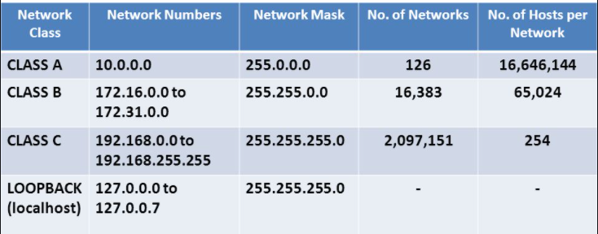
NAT (Network Address Translation) solves the issue of having too many public IP addresses. It assigns private IP addresses so that multiple devices can connect through one big connection.

Slide 5
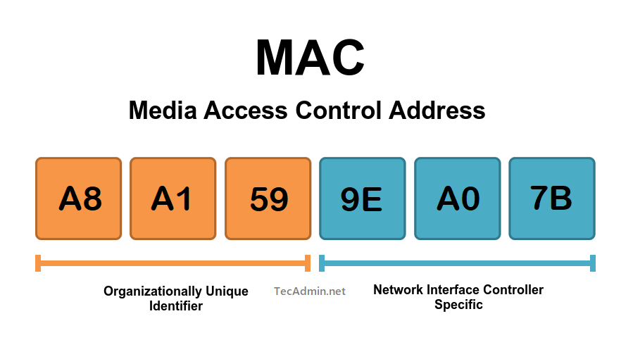
2. MAC Addresses
IPv4 and IPv6 are at layer 3 of the OSI Model, which consists of 7 total layers. (TCP/IP has 5 layers)
MAC, or the physical address, is at layer 2 and is related to switching

Slide 6

ether is the MAC address
You can use a MAC address lookup for the first three pairs of numbers. These are identifiers and will help you identify your device (58:11:22 should be the motherboard manufacturer ASUS)

Slide 7
3. TCP, UDP, and the Three-Way Handshake
TCP and UDP sit on layer 4 (transport layer)
TCP (Transmission Control Protocol) is a connection- oriented protocol. Compared to UDP, it it more reliable and secure (https, ftp, ssh)
UDP (User Datagram Protocol) is a connectionless-oriented protocol. Streaming service, Voice-over-IP (VoIP), and games use this protocol.
TCP and UDP are important for network scanning

Slide 8
3. TCP, UDP, and the Three-Way Handshake
The Three-Way-Handshake – process used by TCP to establish a connection between two devices
The sequence of the three steps are as follows:
SYN (synchronize)
SYN-ACK (synchronize-acknowledge)
ACK (acknowledge)
Once the three-way handshake is complete, the connection is established, and both devices are ready to exchange data.

Slide 9
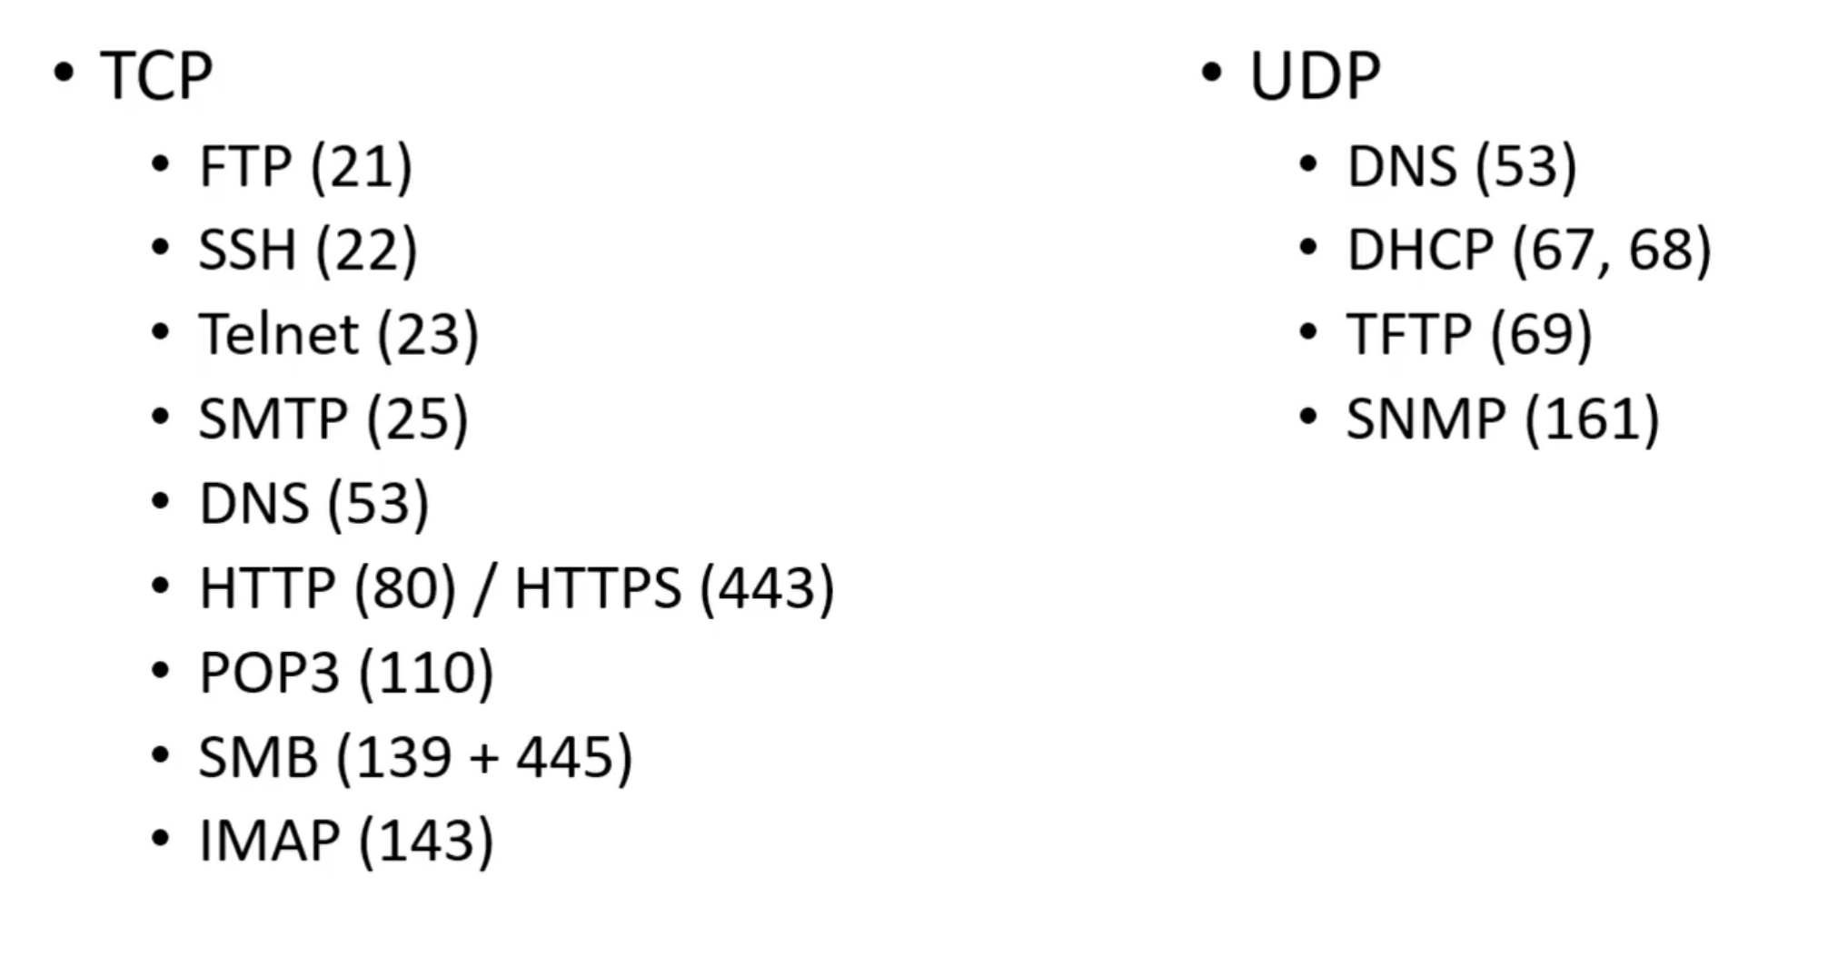
4. Common Ports and Protocols

Slide 10
5. The OSI model
Please Do Not Throw Sausage Pizza Away - memorization saying for the layers
1) Physical - data cables
2) Data - Switching, MAC addressing
3) Network - IP addresses, routing
4) Transport - TCP/UDP
5) Session - session management
6) Presentation - WMV, JPEG, MOV
7) Application - HTTP, SMTP
To troubleshoot, you start from the lowest (physical) layer and go up.

Slide 11
6. Subnetting
Subnetting is the process of dividing a network into smaller subnetworks called subnets. It allows for more efficient use of IP addresses and facilitates network management and routing. Subnetting is commonly used in IPv4 networks

Slide 12
6. Subnetting
CIDR (Classless Inter-Domain Routing) notation is a method used to represent IP addresses and their corresponding subnet masks. It specifies the network prefix length, which indicates the number of bits used for the network portion of the IP address.
CIDR notation is expressed by appending a forward slash (/) followed by the prefix length to the IP address.
For example: 192.168.0.0/24

Slide 13
6. Subnetting
In this example, the IP address is in the format of "192.168.0.0" and the "/24" represents the prefix length, indicating that the first 24 bits represent the network portion of the IP address, while the remaining 8 bits represent the host portion.
With a /24 prefix length, the subnet mask for this network would be 255.255.255.0. This means that the first three octets are reserved for the network, and the last octet can be used for addressing hosts within the subnet.
To subnet this network further, additional bits can be borrowed from the host portion. For instance, if we borrow 2 bits, we can create 4 subnets. The subnet mask would become 255.255.255.192 (in binary: 11111111.11111111.11111111.11000000)

Slide 14
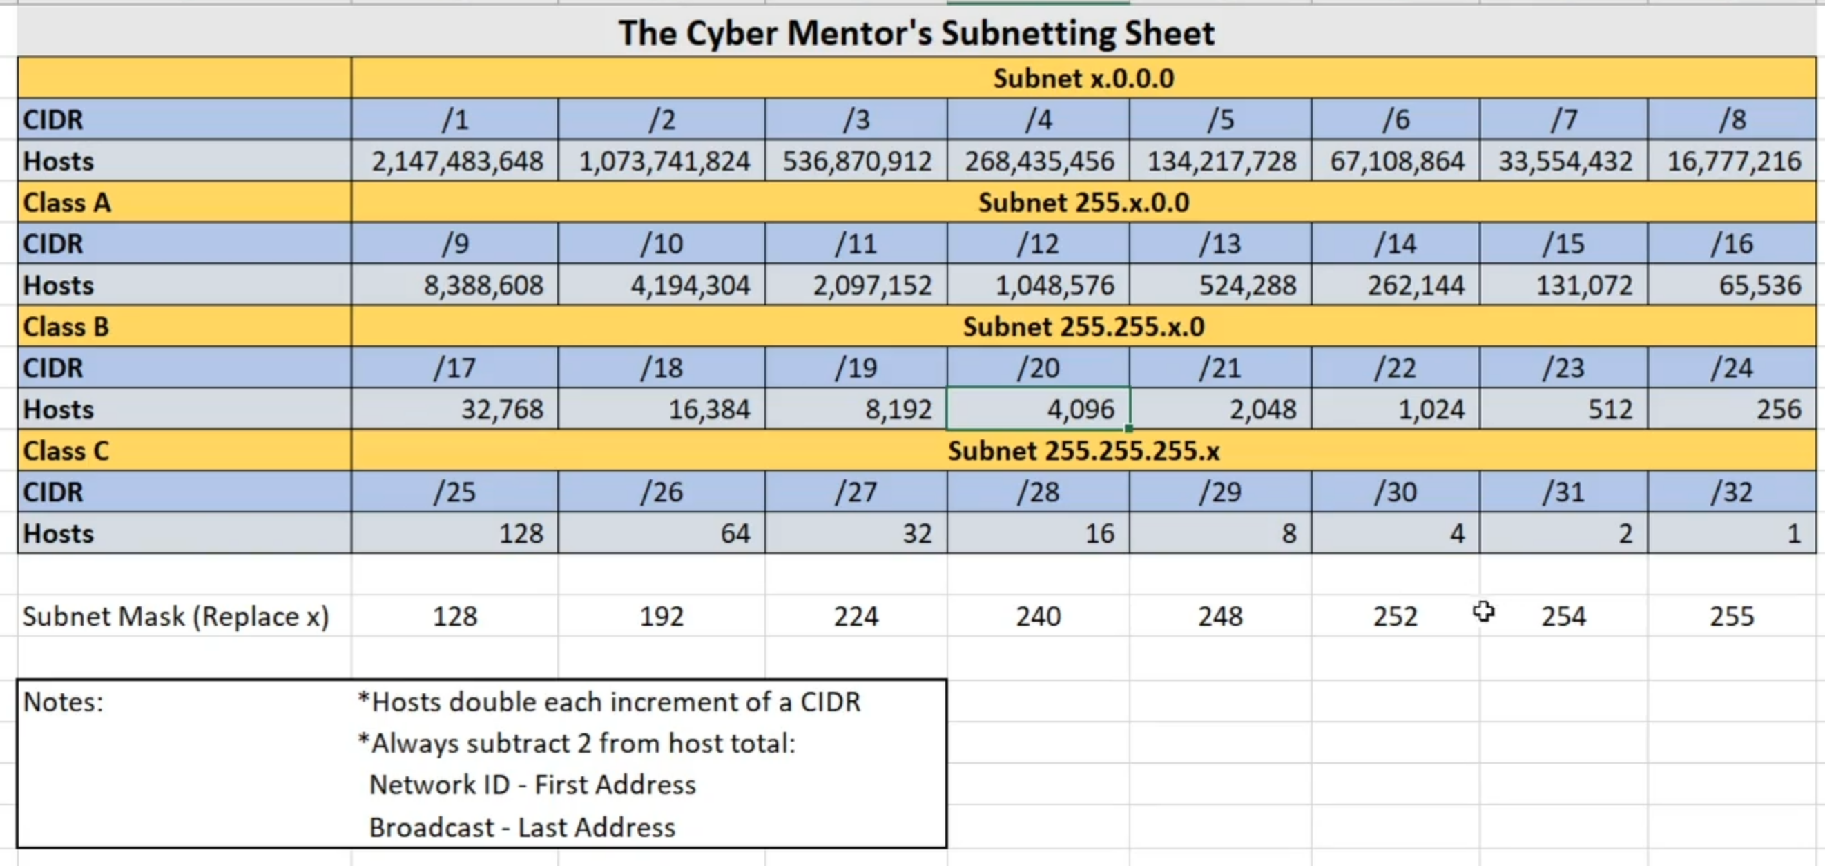
6. Subnetting

Slide 15
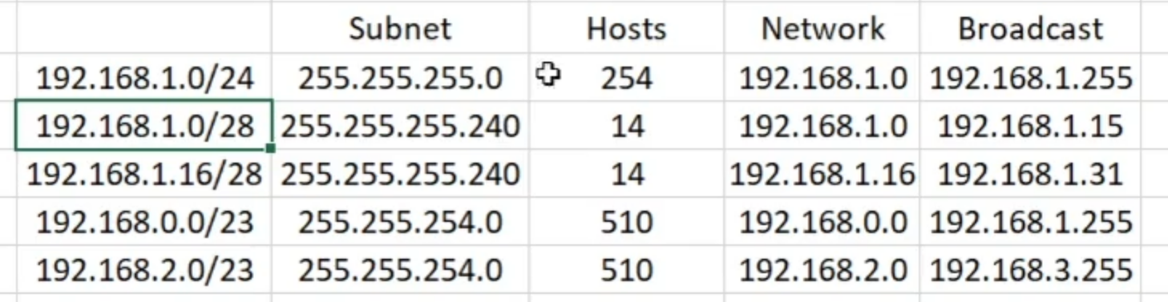

Slide 16
6. Subnetting
Subnet Mask – Explained: https://www.youtube.com/watch?v=s_Ntt6eTn94
Optional video to watch 7 second subnetting: https://www.youtube.com/watch?v=ZxAwQB8TZsM

